Slide 1
AI: The Future of Technology
Exploring the potential of artificial intelligence

Slide 2
What is Artificial Intelligence?
1. Artificial Intelligence (AI) refers to the development of computer systems that can perform tasks that would normally require human intelligence.
2. AI can include abilities such as speech recognition, problem-solving, language translation, and visual perception.
3. The goal of AI is to create machines that can think, learn, and make decisions on their own.

Slide 3
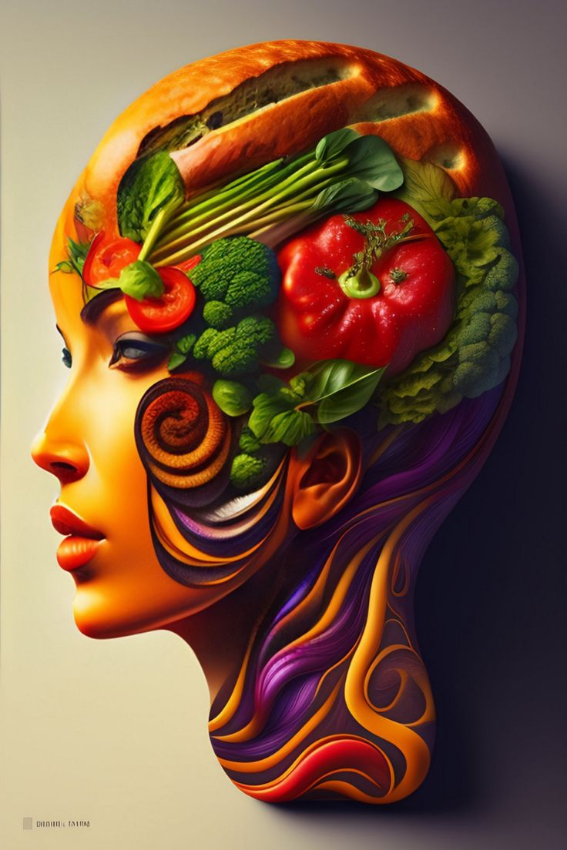
Applications of AI
1. AI is used in various industries, including healthcare, finance, transportation, and entertainment.
2. In healthcare, AI can help with medical diagnosis, drug discovery, and personalized treatment plans.
3. In finance, AI is used for fraud detection, algorithmic trading, and customer service.
4. In transportation, AI is employed in self-driving cars and traffic management systems.
5. In entertainment, AI is utilized for recommendation systems, virtual assistants, and video game opponents.

Slide 4
Benefits and Challenges of AI
1. Benefits of AI include increased productivity, improved efficiency, and enhanced decision-making.
2. AI can automate repetitive tasks, allowing humans to focus on more complex and creative work.
3. However, challenges of AI include ethical concerns, job displacement, and biases in algorithms.
4. Ethical considerations arise regarding privacy, data security, and the potential misuse of AI technology.
5. Job displacement is a concern as automation may replace certain roles, requiring workforce reskilling and retraining.

Slide 5
The Future of AI

Slide 6
Thank you!

